Slide 1
Dealing with Conflicting Updates in Git
CS 5010 Program Design Paradigms
“Bootcamp”
Lesson 0.6
© Mitchell Wand, 2012-2014
This work is licensed under a Creative Commons Attribution-NonCommercial 4.0 International License.

Slide 2
Learning Objectives
At the end of this lesson you should be able to:
explain what happens when you pull changes from an upstream repository
understand what a conflict is
resolve a simple merge conflict in a text file (including a .rkt file)

Slide 3
A Commit
Remember the basic story from the preceding lesson
my-project
docs
manual.docx
user_docs.docx
src
main.rkt
module1.rkt
module2.rkt
module3.rkt
.git
commit
When you do a “commit”, you record all your local changes into the mini-fs.
The mini-fs is “append-only”. Nothing is ever over-written there, so everything you ever commit can be recovered.

Slide 4
Synchronizing with the server (1)
a server, somewhere on the internet, eg. github.com
your local machine
my-project
docs
manual.docx
user_docs.docx
src
main.rkt
module1.rkt
module2.rkt
module3.rkt
.git
push
At the end of each work session, you need to save your changes on the server. This is called a “push”.
Now all your data is backed up.
You can retrieve it, on your machine or some other machine.
We can retrieve it (that’s how we collect homework)

Slide 5
Synchronizing with the server (2)
a server, somewhere on the internet, eg. github.com
your local machine
my-project
docs
manual.docx
user_docs.docx
src
main.rkt
module1.rkt
module2.rkt
module3.rkt
.git
pull
pull
To retrieve your data from the server, you do a “pull”. A “pull” takes the data from the server and puts it both in your local mini-fs and in your ordinary files.
If your local file has changed, git will merge the changes if possible. If it can’t figure out how to the merge, you will get an error message. Dealing with this is beyond the scope of this tutorial ☹

Slide 6
Q: When might you need to merge?
A: When your partner committed some changes to the server, which you don't have.
Your partner's work (on the server)
Your work (on your local machine)
Your last pull

Slide 7
Result of Syncing
Your changes are applied to the latest version on the server. This is called "rebasing"
Combined work now lives on both the server and your local machine.
Your partner's work (on the server)
Your work (on your local machine)

Slide 8
Most of the time, this works well
So long as you and your partner are working on separate parts of the file, this works fine.
Both sets of changes get made, and the history on the server stays linear
But what happens if you and your partner commit incompatible changes?

Slide 9
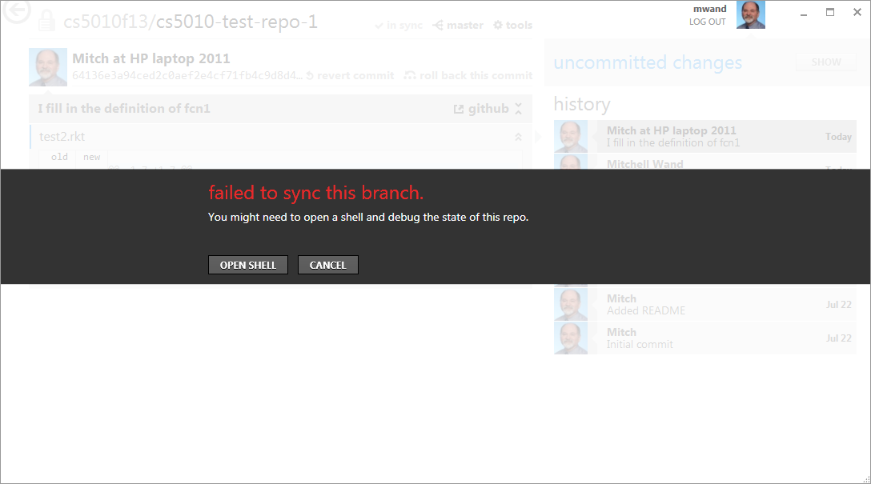
Here's what you'll see

Slide 10
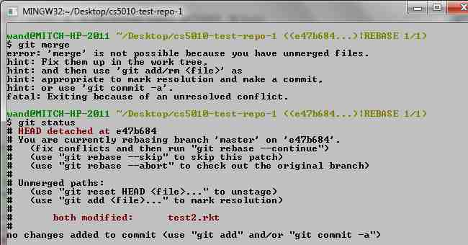
So, click on tools and open a shell
Here's what we're going to do
Don't panic!
First, look at the file in an editor

Slide 11
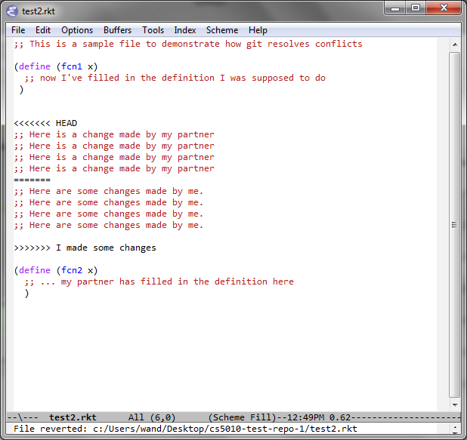
Here's what the conflicted file looks like (in emacs)
what's on the server
what's on the local machine

Slide 12
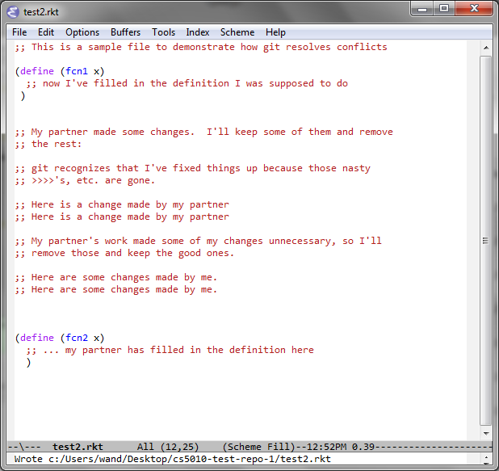
Next: edit the file the way you want it
no more >>>'s

Slide 13
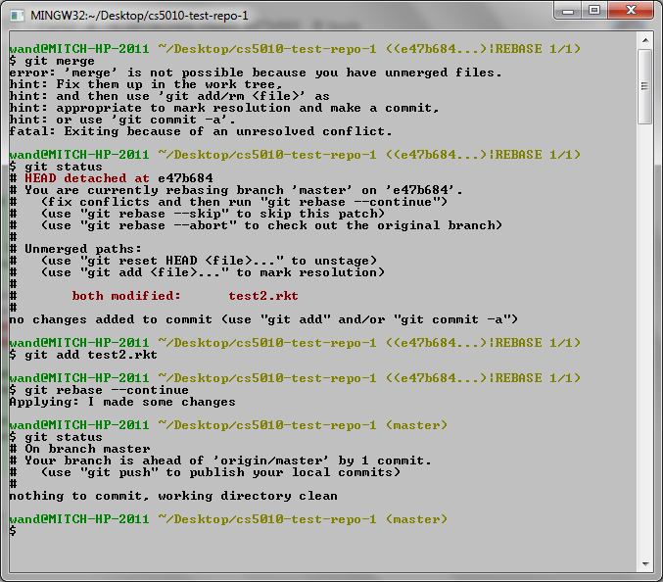
add the fixed-up file to the commit
tell git to continue to the next change
ok! we are ready to sync
if there were more conflicts, we'd have to do this process for each of them.

Slide 14
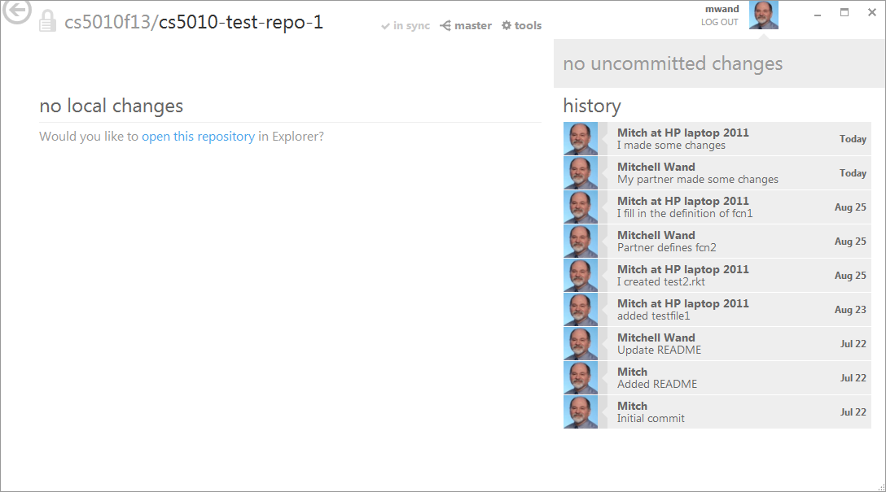
And we're ready to get back to work
Observe that both commits are now in your history

Slide 15
Is this a pain?
Yes, but it shouldn't happen too often.
Your interaction with the shell might look somewhat different.
But the workflow is the same:
identify the files that are conflicted
identify and resolve the conflicts in each file
the conflicted region will be marked with >>>'s.
Use your favorite text editor for this.
When you get the file the way you want it, add it to your commit.
Commit all the fixed-up files.

Slide 16
Summary
In this lesson you have learned
what happens when you pull changes from an upstream repository
what a conflict is
how to resolve a simple merge conflict in a text file (including a .rkt file)

